Slide 1
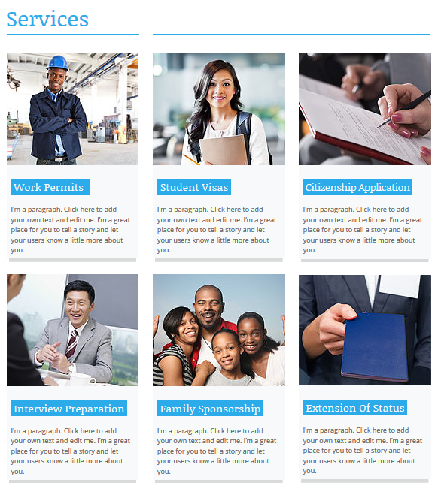
Service pages
Preference 1
( Engineering services and consultancy management) ( if you click in this.. a page like this will appear)
https://www.wix.com/website-template/view/html/1327?originUrl=https%3A%2F%2Fwww.wix.com%2Fwebsite%2Ftemplates%2Fhtml%2Fbusiness%2Fconsulting-coaching%2F2&bookName=&galleryDocIndex=11&category=business

Slide 2

Different services of engineering and management consultation section:
Preference 1
For sub points of sections of Engineering services and consultancy management, the contents like it solutions, project management will be placed with pictures and docs.
Preference 2
https://www.slalom.com/services/experience-design
Preference 3
https://www.slalom.com/services/experience-design

Slide 3

Home page: (landing page)
Preference 1
For landing page, use this link as a reference for about us and why optima and slider type and also footer. (HOME PAGE) Make the slider title capitalized and other things as per i said and in the link
https://www.wix.com/website-template/view/html/1723?originUrl=https%3A%2F%2Fwww.wix.com%2Fwebsite%2Ftemplates%2Fhtml%2Fbusiness%2F1&bookName=create-master-new&galleryDocIndex=6&category=business&metaSiteId=

Slide 4
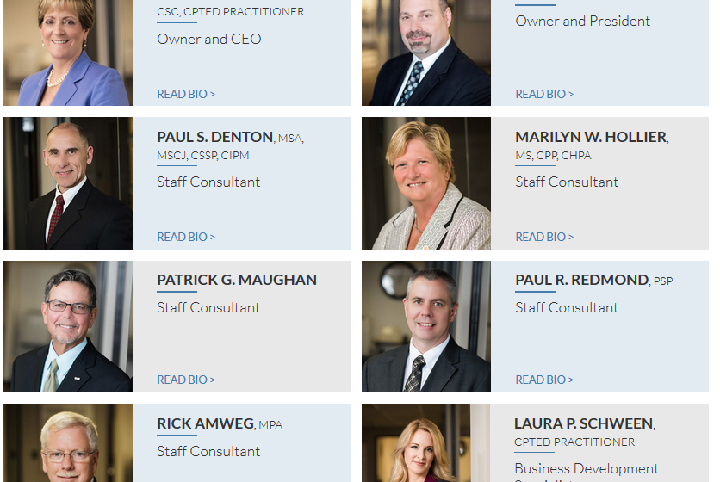
About us page:
Preference 1
For about us page, use this reference.
https://srmcllc.com/about/

Slide 5

Latest News:
The slider of latest news will be as of this link.
https://www.brac.net/tup?view=page

